Slide 1
Member Informational Meetings
City of Quincy

Slide 2
Your health care dollars deserve to go further. A lot further.
We deliver care that works better and
is easier to understand.

Slide 3

Local Strength. National Reach.
#1 ranked health insurance brand in America¹
106 million
93%
1 in 3
Americans
members
of doctors
More than
82%
96%
1 million
of hospitals
providers
of the Fortune 100

Slide 4
We know Massachusetts cities.
That’s why we’re chosen locally more than any other brand.
Blue Cross Blue Shield of Massachusetts
Plan members:
In Massachusetts:
Affiliations across New England:
2.8M
75
200
members
hospitals
hospitals
18,000
42,000+
providers
providers

Slide 5
Transitioning to Blue Cross.
Wellness
Educational
support
On-site
education
Member
Personalized
communications
Tools and
resources

Slide 6
We're enhancing retiree benefits
& better managing costs.
Retirees have access to our Medex®' plan and
receive the following:
A national network of providers and pharmacies
A richer medical benefit and at least an equivalent pharmacy benefit,
in most cases
Cost savings with lower premiums, even with the purchase of Medicare B, in some cases
Lower out-of-pocket costs
Long-term protection of retiree benefits

Slide 7
Local Care. Superior Coordination.
Patients are left to manage their own health care, such as sharing their medical information with doctors, filling prescriptions, and following their health plan.
They’re burdened with staying on schedule with their health plan and not missing any milestones.
Care Before:
Patient care, patient burden.
Partnering with Blue Cross, your personal doctor manages your health care, including prescriptions, appointment scheduling, and relaying information between doctors.
Patients have a stronger relationship with their personal doctor, and your care is effortlessly coordinated, simple, and easy to access.
Care Now:¹
Patient care, shared responsibility.
Our leadership and consultative model has led to four broad approaches through which providers are improving the quality of care and outcomes, while effectively reducing overall spending.
Care Teams with Expanded Skills
& Expertise
New Referral Relationships and Integration Across Settings
Data Systems
& Advanced Analytics
360° Patient Engagement

Slide 8
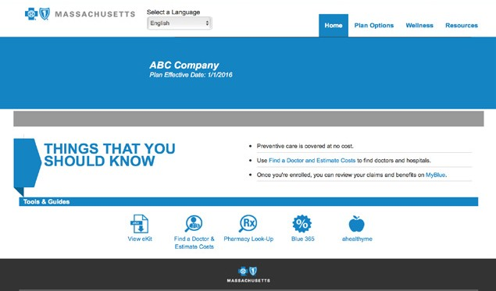
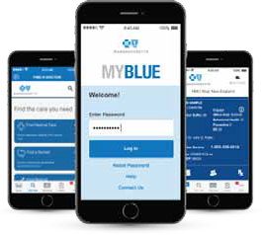
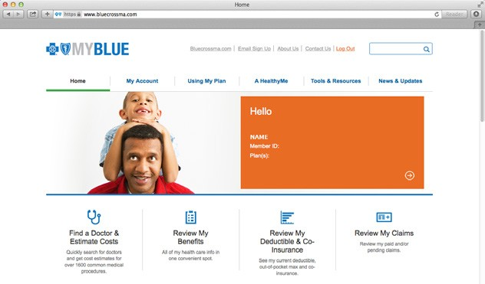
Educate
Decision
Engage
Getting Care
Manage
Claim
Benefits@Blue
Customizable website featuring your benefit options
ID Card
Member ID number and copay information
HealthEquity SSO
HSA, HRA, FSA, and other financial accounts to manage out-of-pocket medical costs
MyBlue
Online member access to health
plan info, claims,
and more
MyBlue Member App
Instant access
to MyBlue via smartphone or tablet
Find a Doctor & Estimate Costs Quickly search for doctors and get cost estimates for common procedures
Message Wire
Text message channel
to connect you
to relevant content
eKit
PDF providing health care coverage and wellness information
Digital Summary of
Health Plan Payments
Simple statements
available online
Find a Doctor & Estimate Costs
Quickly search for doctors
Express Scripts®´´ App
Mail service
pharmacy app
OviaTM
Pregnancy and fertility app
Care4LifeSM Diabetes management app
Care Concierge Telephonic support and coaching from
a registered nurse
HealthEquity App
Manage health financial accounts via smartphone or tablet
Member Service
Award-winning service team available by phone, seven days a week
ahealthyme
Personalized digital
well-being hub
Blue Care® Line
Speak with a registered nurse by calling a toll-free line
Blue365®
Exclusive member health & wellness savings and discounts
Telehealth Convenient live doctor video visit platform
Accumulator
Shows you where you are against your deductible and
out-of-pocket maximum
Coverage Advisor
Decision-support tool that
recommends plan options
SmartShopper®´´ (Coming 2018)
Incentive program in which you use a lower-cost health care provider and you save money on medical costs
Omni-Channel Approach
Phone • Chat • Mobile Alerts • Print • Email • Voice • Video • Face-to-Face

Slide 9
Contact Information
Jason Fortin, Municipal Sales Executive
Email: jason.fortin@bcbsma.com
Direct Dial: 617.246.2928
Cell: 508.471.7003
Steve Dion, Labor Relations
Email: stephen.dion@bcbsma.com
Direct Dial: 617.246.7908
Cell: 617.699.3454

